Slide 1
Gamma-rays from transitional pulsars
P. H. Thomas Tam (Sun Yat-Sen University, China)
@EWASS 2015, Tenerife, Spain
With contributions from
Paul Yeung, David Hui (Chungnam Univ.), Albert Kong, Ray Li (NTHU),
J. Takata, K.S. Cheng, Gene Leung (HKU)

Slide 2
Fermi MSPs, LMXBs
MSPs are gamma-ray emitters
But LMXBs are not
(apart from transitional pulsar systems during disk state)

Slide 3
Gamma-rays from J1023
Not in first Fermi catalog
Discovery using 1.5 year data
Confirmed in second Fermi catalog
Not in third Fermi catalog..
Tam et al. (2010)

Slide 4
Gamma-rays in radio pulsar state
Using 2008-2013 data, a cut-off power-law is preferred over a PL fit by ~3 sigma, with Γ = 1.4±0.6, Ec = 0.7±0.4 GeV (Takata et al. 2014)
Luminosity~10^33 erg s^-1 >~ 0.3% spin-down luminosity
No variation on spin nor orbital period was found (Tam et al. 2010)
A low-significance claim on a gamma-ray pulsation on pulsar rotation period (Archibald et al. 2013)

Slide 5
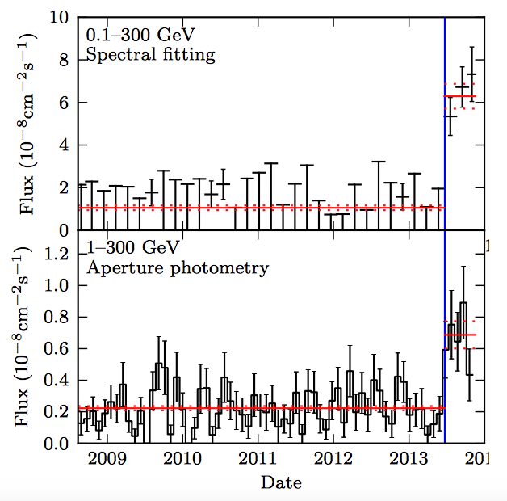
State-change in summer 2013
Dramatic increase in gamma-ray flux in July 2013 (Stappers et al. 2014)

Slide 6
State-change in summer 2013
We constrain the change from the low state to high state in gamma-rays between June 29 - July 5, 2013; it stays as such until recently

Slide 7
accretion disk state
After 2013 July, a cut-off power-law is preferred over a PL fit by ~3 sigma, with Γ = 1.8±0.2, Ec = 2.3±0.9 GeV (Takata et al. 2014)
Flux increases by ~an order of mag w.r.t. pulsar state
We did not find any modulation on the spin nor orbital period

Slide 8
So, what’s the origin of gamma-rays from J1023?
Pulsar state (low gamma flux):
Magnetospheric emission is highly expected, given the cutoff power-law (c.f. gamma-ray pulsation reported for another transitional pulsar XSS J12270-4853). But models involving intrabinary shock are still possible (c.f. PSR B1957+20, Wu et al. 2012; PSR J1311-3430, Xing & Wang 2015)
Accretion disk state (high gamma flux):
Not clear. But it should be related to the existence of the accretion disk. Proposed models: Pulsar wind IC up-scatter UV disk photons (Takata et al. 2014), Propellar accretion (Pappito & Torres 2015), enhanced shock, jet (Bogdanov et al. 2014) etc.

Slide 9
Takata et al. (2014) pulsar wind IC model for gamma-rays

Slide 10
Gamma-rays from J1227
1FGL source, similarity with J1023 first noted in Hill et al. (2011)
At that time it was in a LMXB state

Slide 11
Gamma-ray flux & spectral variability
The flux shows substantial variation in 2008-2012
Flux lower and spectrum different after 2012
Orbital modulation claimed after 2012 (Xing & Wang 2015)
state change
Tam et al. (2014)

Slide 12
Discovery of PSR J1227-4853: radio and gamma pulsation
Johnson et al. 2015
Roy et al. 2015
Currently rotation-powered

Slide 13
So, what’s the origin of gamma-rays from J1227?
Pulsar state (low gamma flux):
Detection of gamma-ray pulsation clearly indicates magnetospheric emission. Low-significance orbital modulation claimed after 2012.
Accretion disk state (high gamma flux):
Again not clear. The disk should play a role again. Proposed models: Pulsar wind IC up-scatter disk photons (Tam et al. 2014, Bednarek 2015), Propellar accretion (Pappito et al. 2014), enhanced shock, etc.

Slide 14
Fermi as an all-sky monitor

Slide 15
Fermi as an all-sky monitor
It scans the whole sky every 3 hours, thus automatically monitors all known (and unknown) transitional pulars all the time
J1023 has greatly enhanced gamma-ray flux in the disk state, J1227 less so.
More?

Slide 16
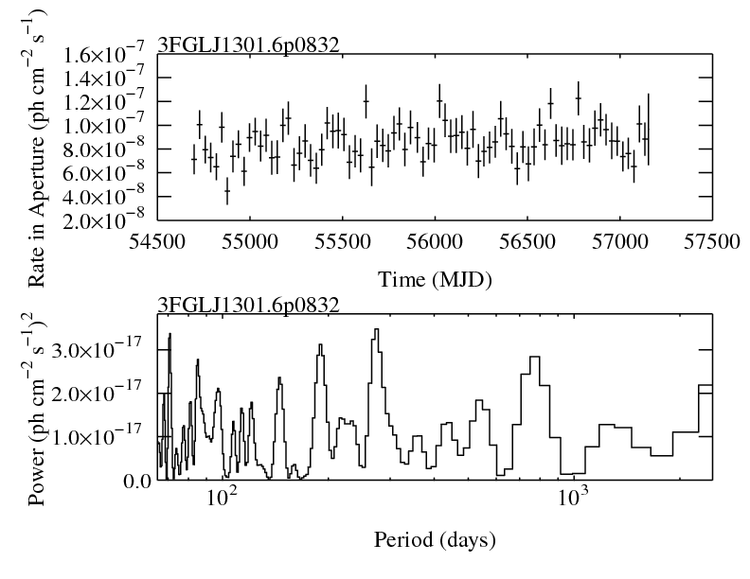
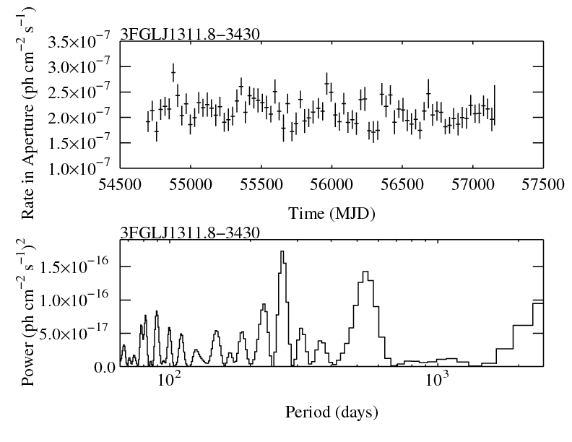
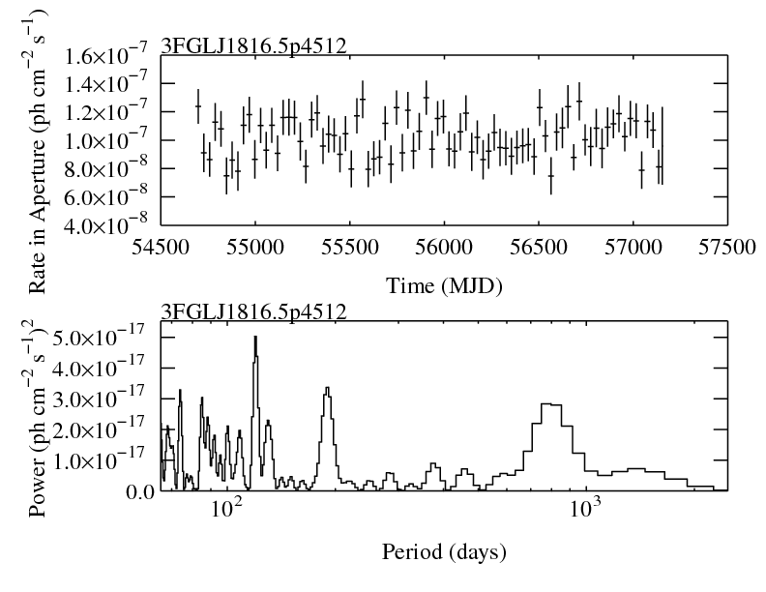
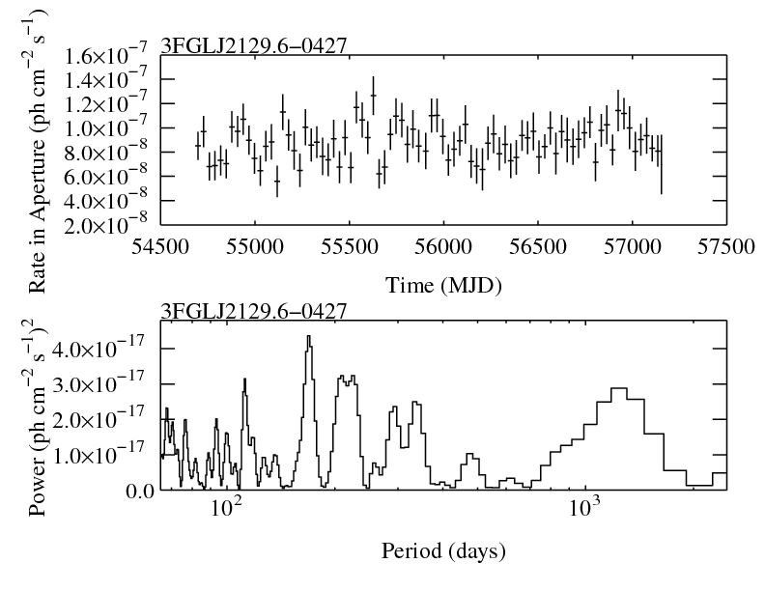
Other redbacks show no change
P.S. New data (Pass8) just released last night!

Slide 17
Summary
Contempaneous change in gamma-rays as in other wavelengths during state change in J1023 and J1227
Emission models unclear esp. accretion disk state
Fermi continues monitoring the whole sky

